Slide 1

Campaign And Strategy

Slide 2
MARKETING
DIGITAL MARKETING
PHYSICAL MARKETING

Slide 3
IST’S ACHIEVMENTS
MAILS
ALUMNI’S SUCCESSS
SHOWCASING
YOUTUBE
DIGITAL MARKETING
FYP’S SHOWCASING
SOCAIL PLATFORMS
INSATGRAM
CAMPUS LIFE
FACEBOOK
WEBINAR
WHATSAPP

Slide 4
We will do digital marketing till admissions; In start we will go with slow speed with passage of time we will increase boosting speed, so that our pages can get enough reach which will help us before admissions so that we don’t have to start from zero. Only webinars will be once in a month.
We are required The Data of Alumni and FYPs Book from DSA for their showcasing and we assure you that it will be kept confidential. Support from regarding department is also required for FYPs showcasing.
We need data about IST achievements from IST which will also be kept confidential.
For webinars we need all departments faculty member for answering the students at other colleges about the programs which we are offering.
For boosting our pages, we need financial help from IST depending upon boosting we required it will vary.

Slide 5
SPEAKER FROM FACULTY
Our respected faculty member will talk about the programs we are offering and their significance.
Why IST?
VIDEO DIARY
IST ACHIEVMENTS
CAMPUS LIFE
ALUMNI SUCCESS STORIES
PHYSICAL MARKETING
FYPS SHOWCASING
Student and there regarding faculty member will talk about their projects
TECH RELATED ACTIVITES
We will Collaborate with tech related societies and take their representative with their material, or we will carry breadboard, ICs and microcontrollers so that a student can perform on it and will get them interested.
OPEN DAY

Slide 6
ONE OPEN HOUSE WE ARE PLANING FOR RETARGETING OUR TARGET AUDIENCE.
OPEN DAY
MAKING THEM TO EXPERIENCE CAMPUS LIFE
INTEREACTIVE SESSION IN AUDITORIUM ABOUT IST
TECH RELATED ACTIVITES IN OUR LABS

Slide 7

REQUIREMENTS FOR PHYSICAL MARKETING
Transport service for on site events and seminars.
Standees and poster for on site events and for open day marketing.
Pamphlets of 6*8 size which we can distribute among our target audience.
Need a faculty member as speaker.
Need students, their FYPs and there regarding faculty member for showcasing of their projects.
Need a mic, speaker and projector for on site events.

Slide 8
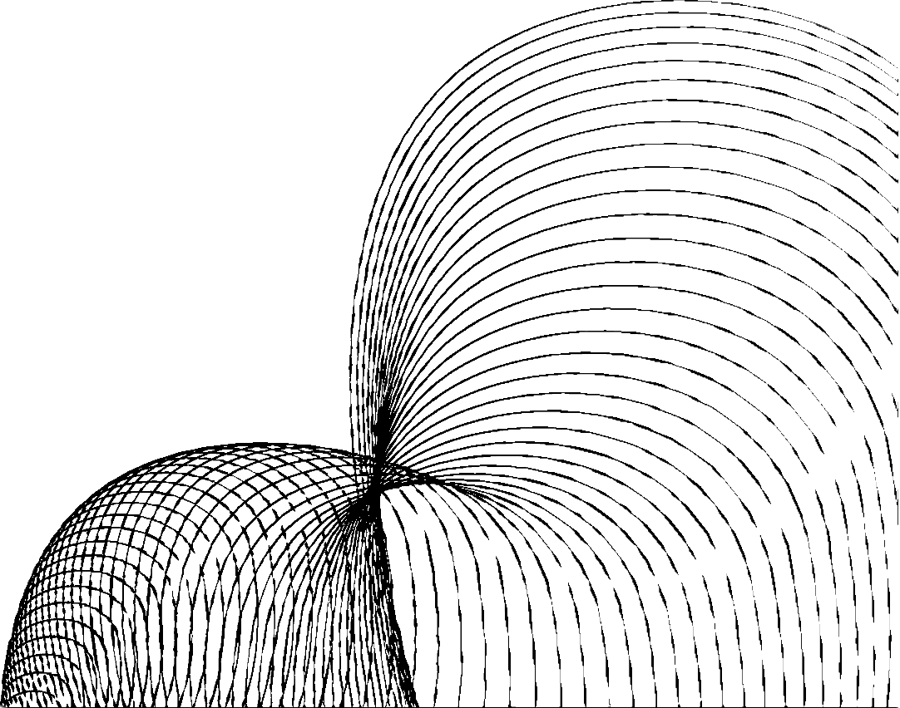
OUR Mission
Our primary aim is to enhance the recognition and reputation of the Institute of Space Technology (IST) among schools and colleges, and through this collaboration, we aspire to achieve several key objectives.

Slide 9

GOAL 01: INCREASED VISIBILITY OF IST
We intend to significantly elevate the visibility of IST in the education sector, reaching out to a wider audience, particularly in schools and colleges. By utilizing effective marketing strategies, engaging digital content, and compelling narratives, we plan to draw attention to IST's exceptional academic programs, research initiatives, and technological innovations.

Slide 10

GOAL 02: SHOWCASING IST'S STRENGTHS IN OTHER INSTITUTES
Another critical goal of our proposal is to showcase the strengths and accomplishments of IST within other educational institutions. We aim to organize informative seminars and webinars where our experts will present their research findings, share insights, and provide students with a glimpse into the world of space technology and engineering. This will not only inspire the youth but also establish IST as a beacon of excellence in the field

Slide 11

GOAL 03: MUTUAL BENEFITS FOR IST AND ITS STUDENTS
We believe that a collaborative effort between IST and schools and colleges can bring mutual benefits. By engaging with these institutions, we aim to create opportunities for IST students to gain exposure to diverse educational environments, learn from their peers, and share their knowledge. Additionally, through outreach activities, we intend to identify potential talents from schools and colleges which could benefit our Institute.

Slide 12
Before any marketing
We require data from admissions office regarding admissions of past five years so that we can plot graphs on their number and than we will study about their trends and firstly we will find problem and then we will try to resolve them with your help.
We will plot number of graphs regarding.
Male/female ratio
Day scholars/Hostilities ratio
Number of students which left IST in their starting semesters.
Demographic Ratio

Slide 13
NOTE
After studying our trends, we will first go for our strong point so that we can give best where we are better
After that we will go for our weak points so that we can left an image of IST in every mind of our targeted audience.

